Slide 1

From zero to hero: creating a reflective loader in C#
Jean-François Maes
SANS Pen Test Hackfest Europe 2021

Slide 2

Agenda
1
Why C#?
2
What is reflection?
3
Creating a loader
4
Improving the loader
5
Future of tradecraft

Slide 3
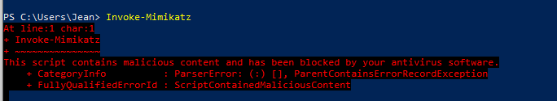
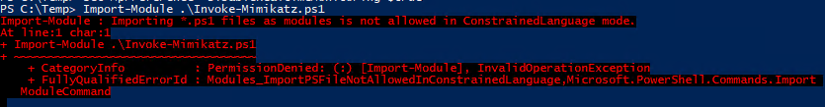
Why C#
AMSI
As defenses improve, so does malware.
Offensive operations will always be a game of cat and mouse between attackers and defenders.
As PowerShell became more and more scrutinized over the years, its defensive capabilities grew as well. AMSI and Constrained Language Mode are two big advancements, but other defensive measures are relevant as well such as script block logging
Constrained Language Mode

Slide 4

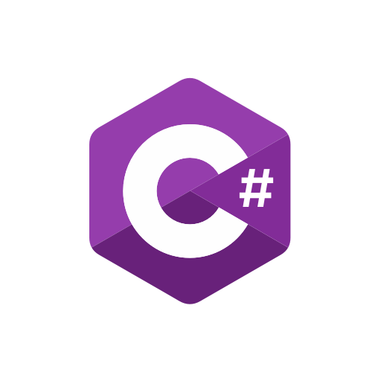



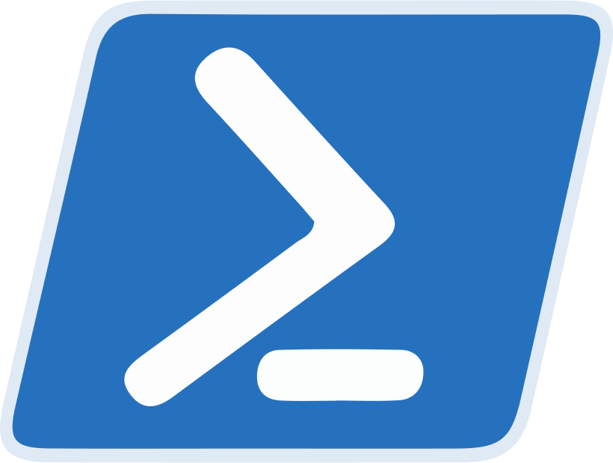


Why C#
Shoutout to

Slide 5


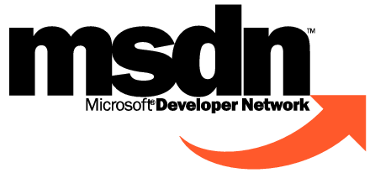
What is reflection?
Wikipedia
Microsoft
Stack Overflow
In computer science, reflection programming is the ability of a process to examine, introspect, and modify its own structure and behavior. A language supporting reflection provides a number of features available at runtime that would otherwise be difficult to accomplish in a lower-level language.
Reflection provides objects that describe assemblies, modules, and types. You can use reflection to dynamically create an instance of a type, bind the type to an existing object, or get the type from an existing object and invoke its methods or access its fields and properties. If you are using attributes in your code, reflection enables you to access them.
Reflection allows you to write code that can inspect various aspects about the code itself.
It enables you to do simple things like Loading an assembly at runtime, finding a specific class, determining if it matches a given Interface, and invoking certain members dynamically.

Slide 6


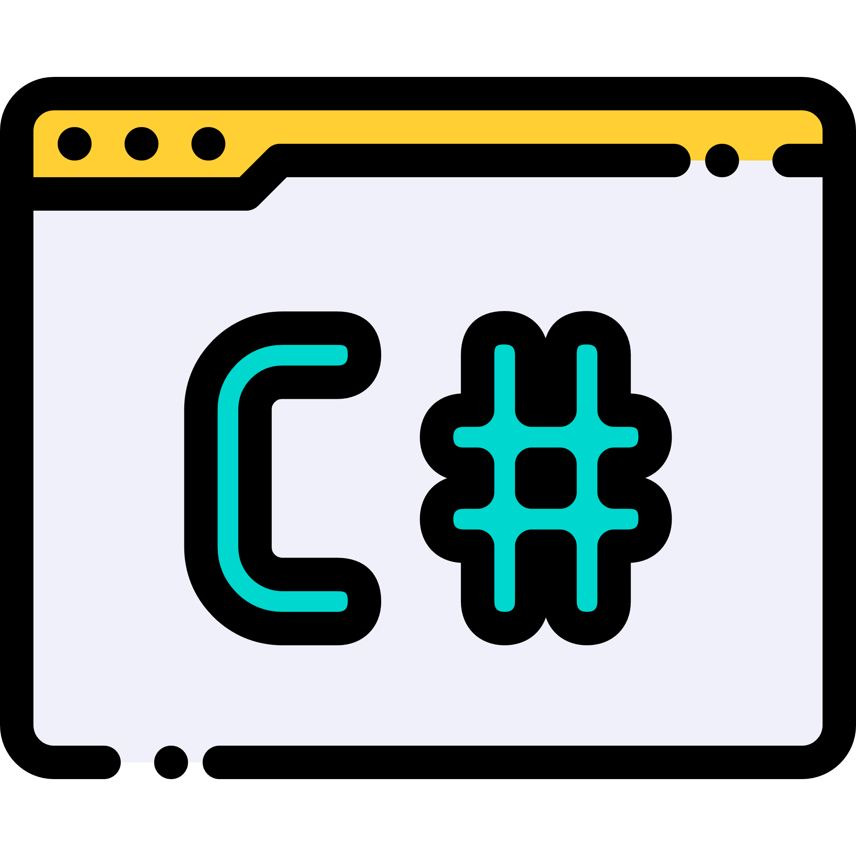
Creating the loader
Loader 1- Ragnaros - “The PoC stage”
Reflection

Slide 7
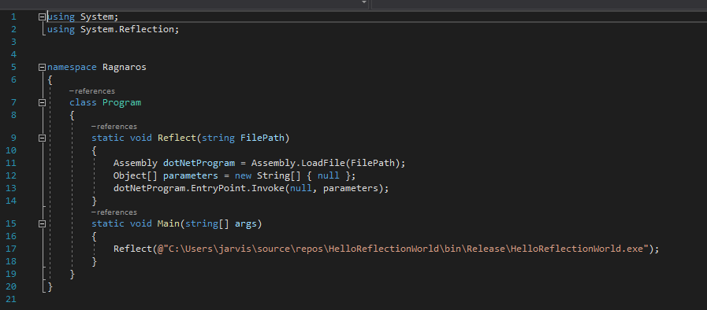
Creating the loader
Loader 1- Ragnaros - “The PoC stage”
Code | Explanation
Assembly.loadFile(string FilePath) | Loads the .NET assembly from the filepath, returns an Assembly object
Object[ ] parameters = new String[] {null} | Creates a new Object Array which contains a new (empty) String Array
EntryPoint.Invoke(null, parameters) | Executes the entry point of the loaded assembly (usually the main method of a program will be the entry point). Passes the parameters to the function (in this case an empty String array

Slide 8

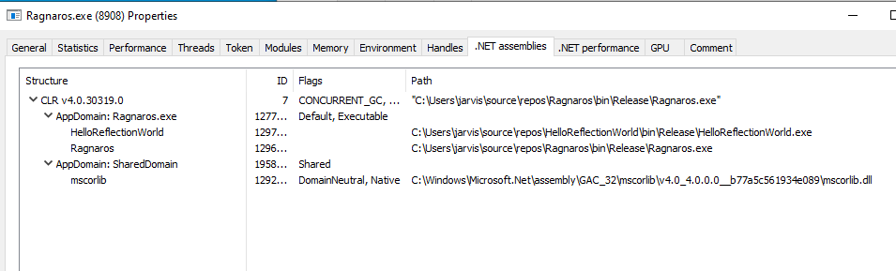
Flaws in Ragnaros
AMSI
No remote fetch
ETW

Slide 9

Expanding the loader
Loader 2- Illidan - “The Web angle”
Reflection

Slide 10
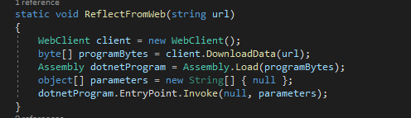
Expanding the loader
Loader 2- Illidan - “The Web angle”
Code | Explanation
Webclient client = new WebClient(); | Initiates a new WebClient object that can then be used to make web requests
Byte[] programBytes = client.DownLoadData(String url) | Will use the webclient to make a request to the url, and download a byte array (if present)
Assembly dotnetProgram = Assembly.Load(programBytes) | Instead of loading an Assembly from a filepath, this function will instead load the assembly from the bytearray.

Slide 11
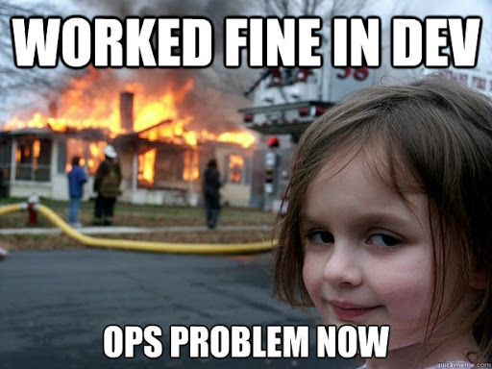


Flaws in Illidan
What happens if there is a 404 error? What about HTTPS?

Slide 12
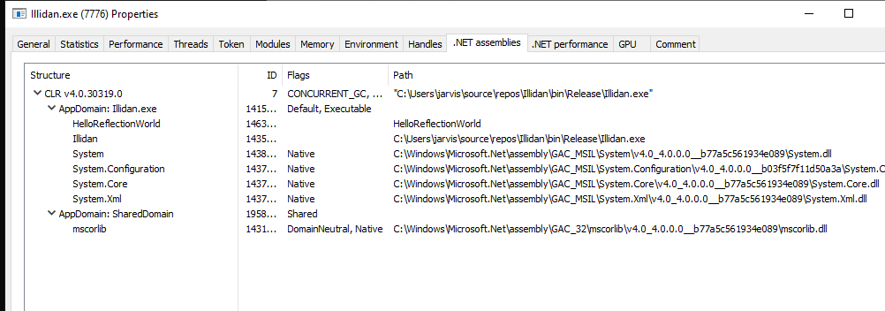
Flaws in Illidan
AMSI
ETW

Slide 13

Expanding the loader
Loader 3- Arthas - “Adding robustness to the web angle”
Poll until !404 or retry limit hit

Slide 14
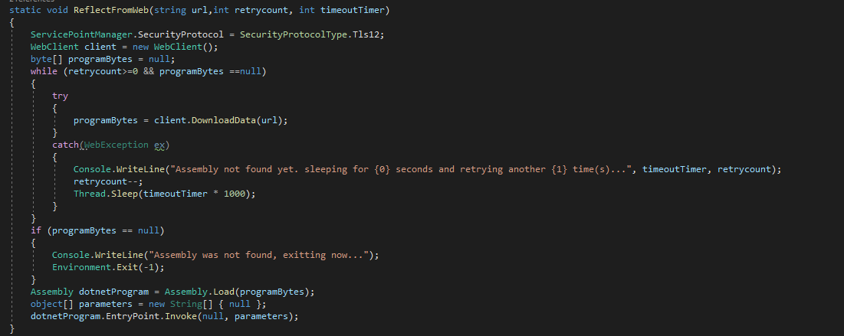
Expanding the loader
Loader 3- Arthas - “Adding robustness to the web angle”
Code | Explanation
ServicePointManager.SecurityProtocol = SecurityProtocolType.Tls12; | Makes sure webclient supports HTTPS traffic
while (retrycount>=0 && programBytes ==null) | Will keep trying to fetch the program over the web until it can or the retrycounter gets below 0.
Try…catch | Handles web errors (404)
if (programBytes == null) | If the loader did not load the program successfully, exit gracefully

Slide 15

Flaws in Arthas

Slide 16
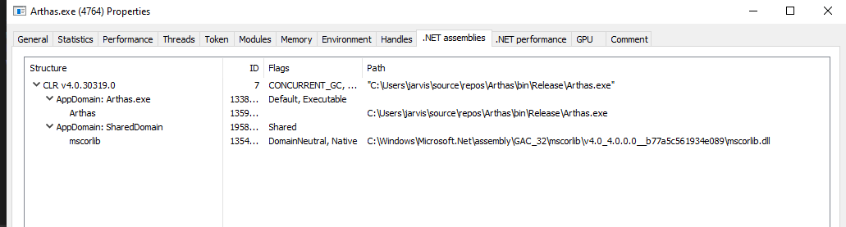
Flaws in Arthas
AMSI
ETW

Slide 17

Flaws in Arthas

Slide 18
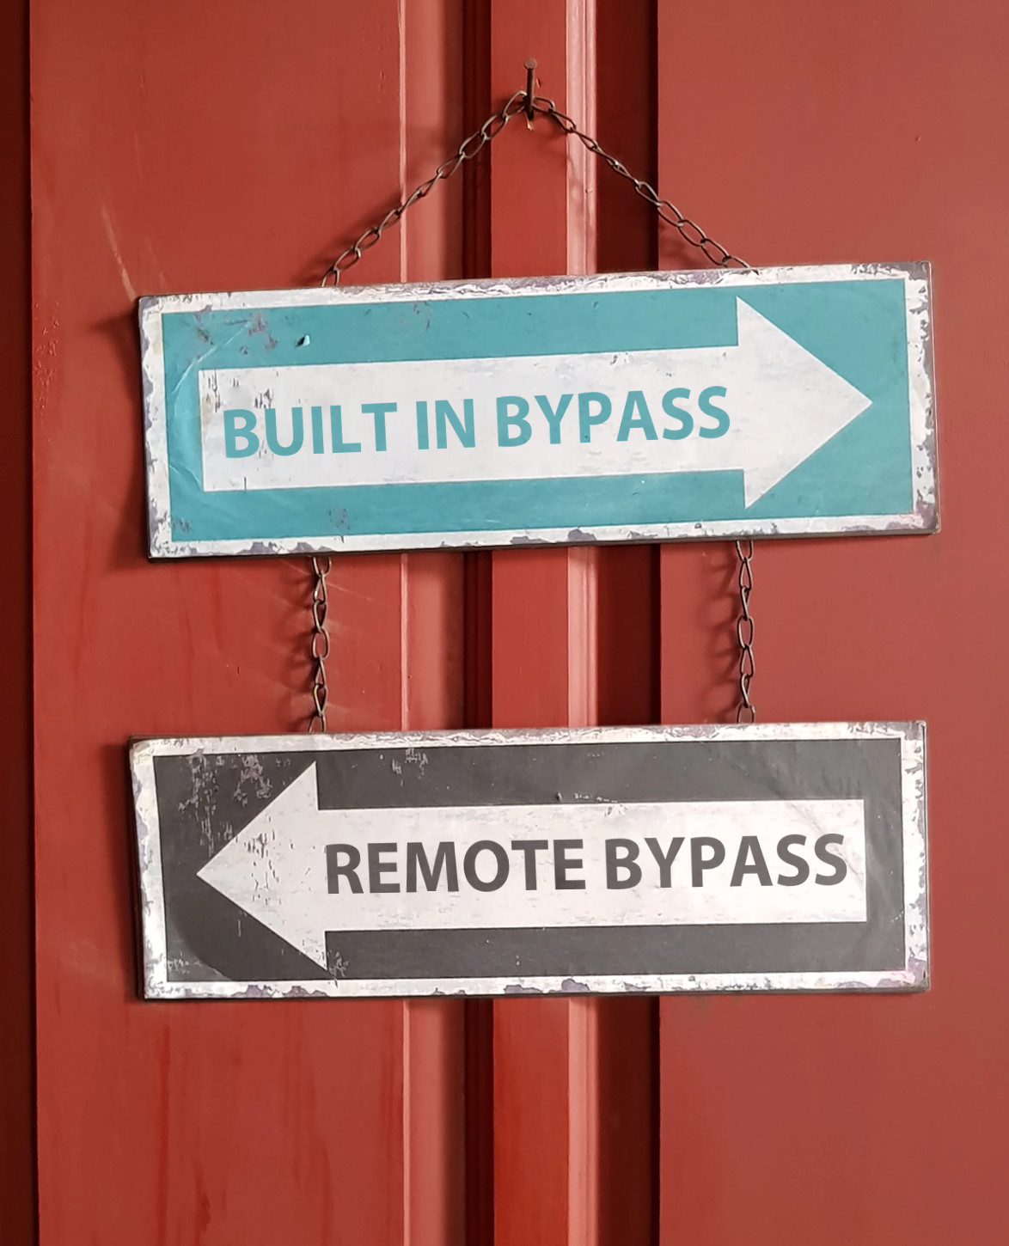
Flaws in Arthas

Slide 19

Double Rainbow Reflection? What does it mean?!
Poll until !404 or retry limit hit
ETW/AMSI patch
Poll until !404 or retry limit hit
Actual assembly

Slide 20
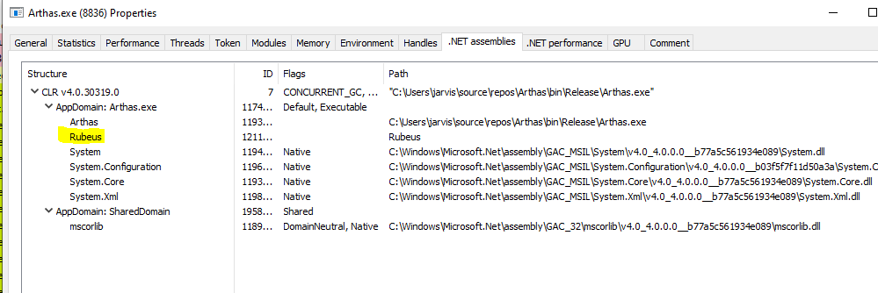
Flaws in Arthas
Pre AMSI patch
Pre ETW patch

Slide 21
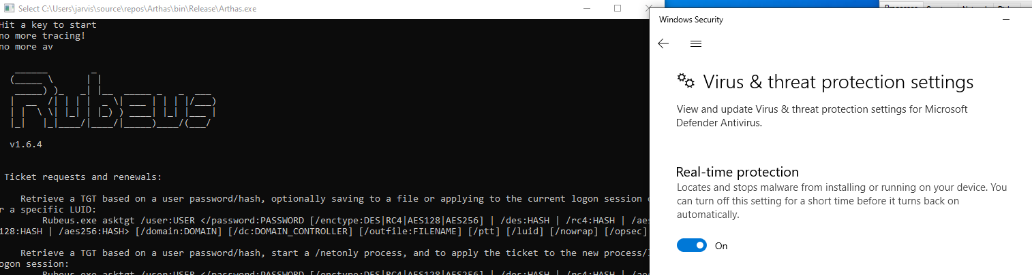
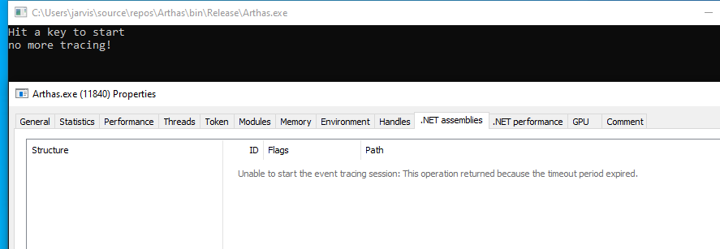
Double Load FTW

Slide 22

Expanding the loader
Loader 4 - DeathWing - “Appdomains are cool”
Application Domains allow us to load and unload binaries at will, whilst keeping the original process open.
This gives us flexibility in case we want a reflective loader that is capable of running multiple assemblies without having to restart the loader

Slide 23
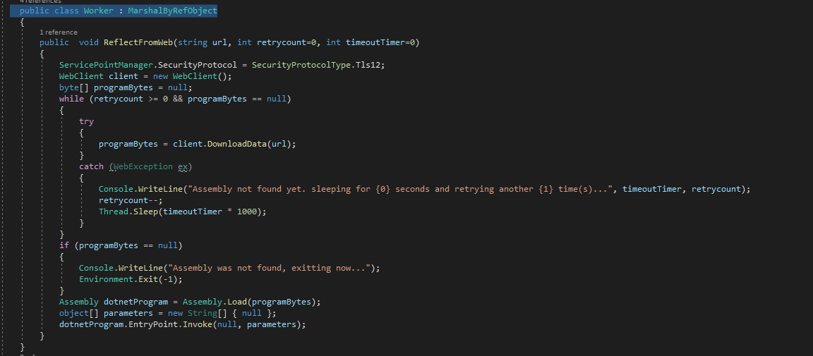
Expanding the loader
Loader 4 - DeathWing - “Appdomains are cool”
Code | Explanation
Public class worker: MarshalByRefObject | Enables access to objects across application domain boundaries in applications that support remoting.

Slide 24
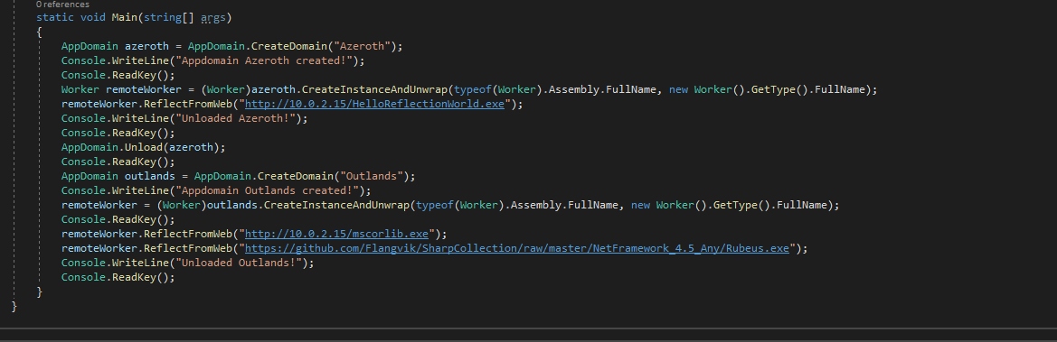
Expanding the loader
Loader 4 - DeathWing - “Appdomains are cool”
Code | Explanation
Appdomain azeroth = AppDomain.CreateDomain(“Azeroth”) | Creates a new appdomain
Worker remoteWorker = (Worker)azeroth.CreateInstanceAndUnwrap(typeof(Worker).Assembly.FullName, new Worker().GetType().FullName); | Activates the worker class
Notes:
https://docs.microsoft.com/en-us/dotnet/api/system.appdomain.createinstanceandunwrap?view=net-5.0

Slide 25
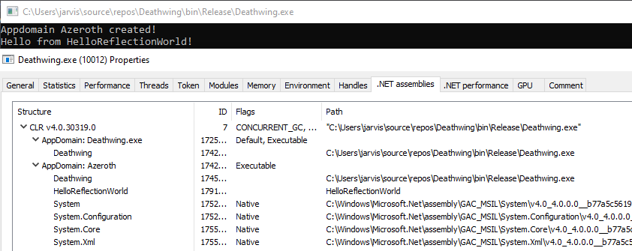
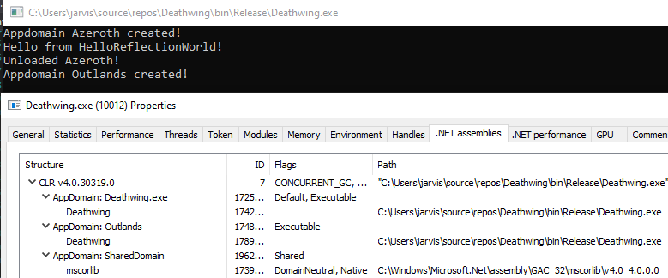
Expanding the loader
Loader 4 - DeathWing - “Appdomains are cool”
Notes:
https://docs.microsoft.com/en-us/dotnet/api/system.appdomain.createinstanceandunwrap?view=net-5.0

Slide 26
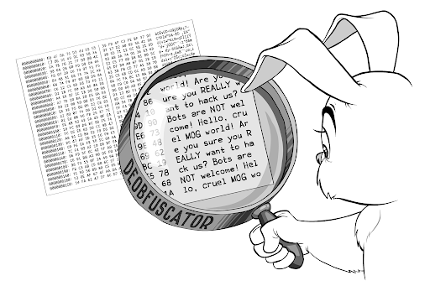

Potential Future improvements
Obfuscation
Encryption

Slide 27

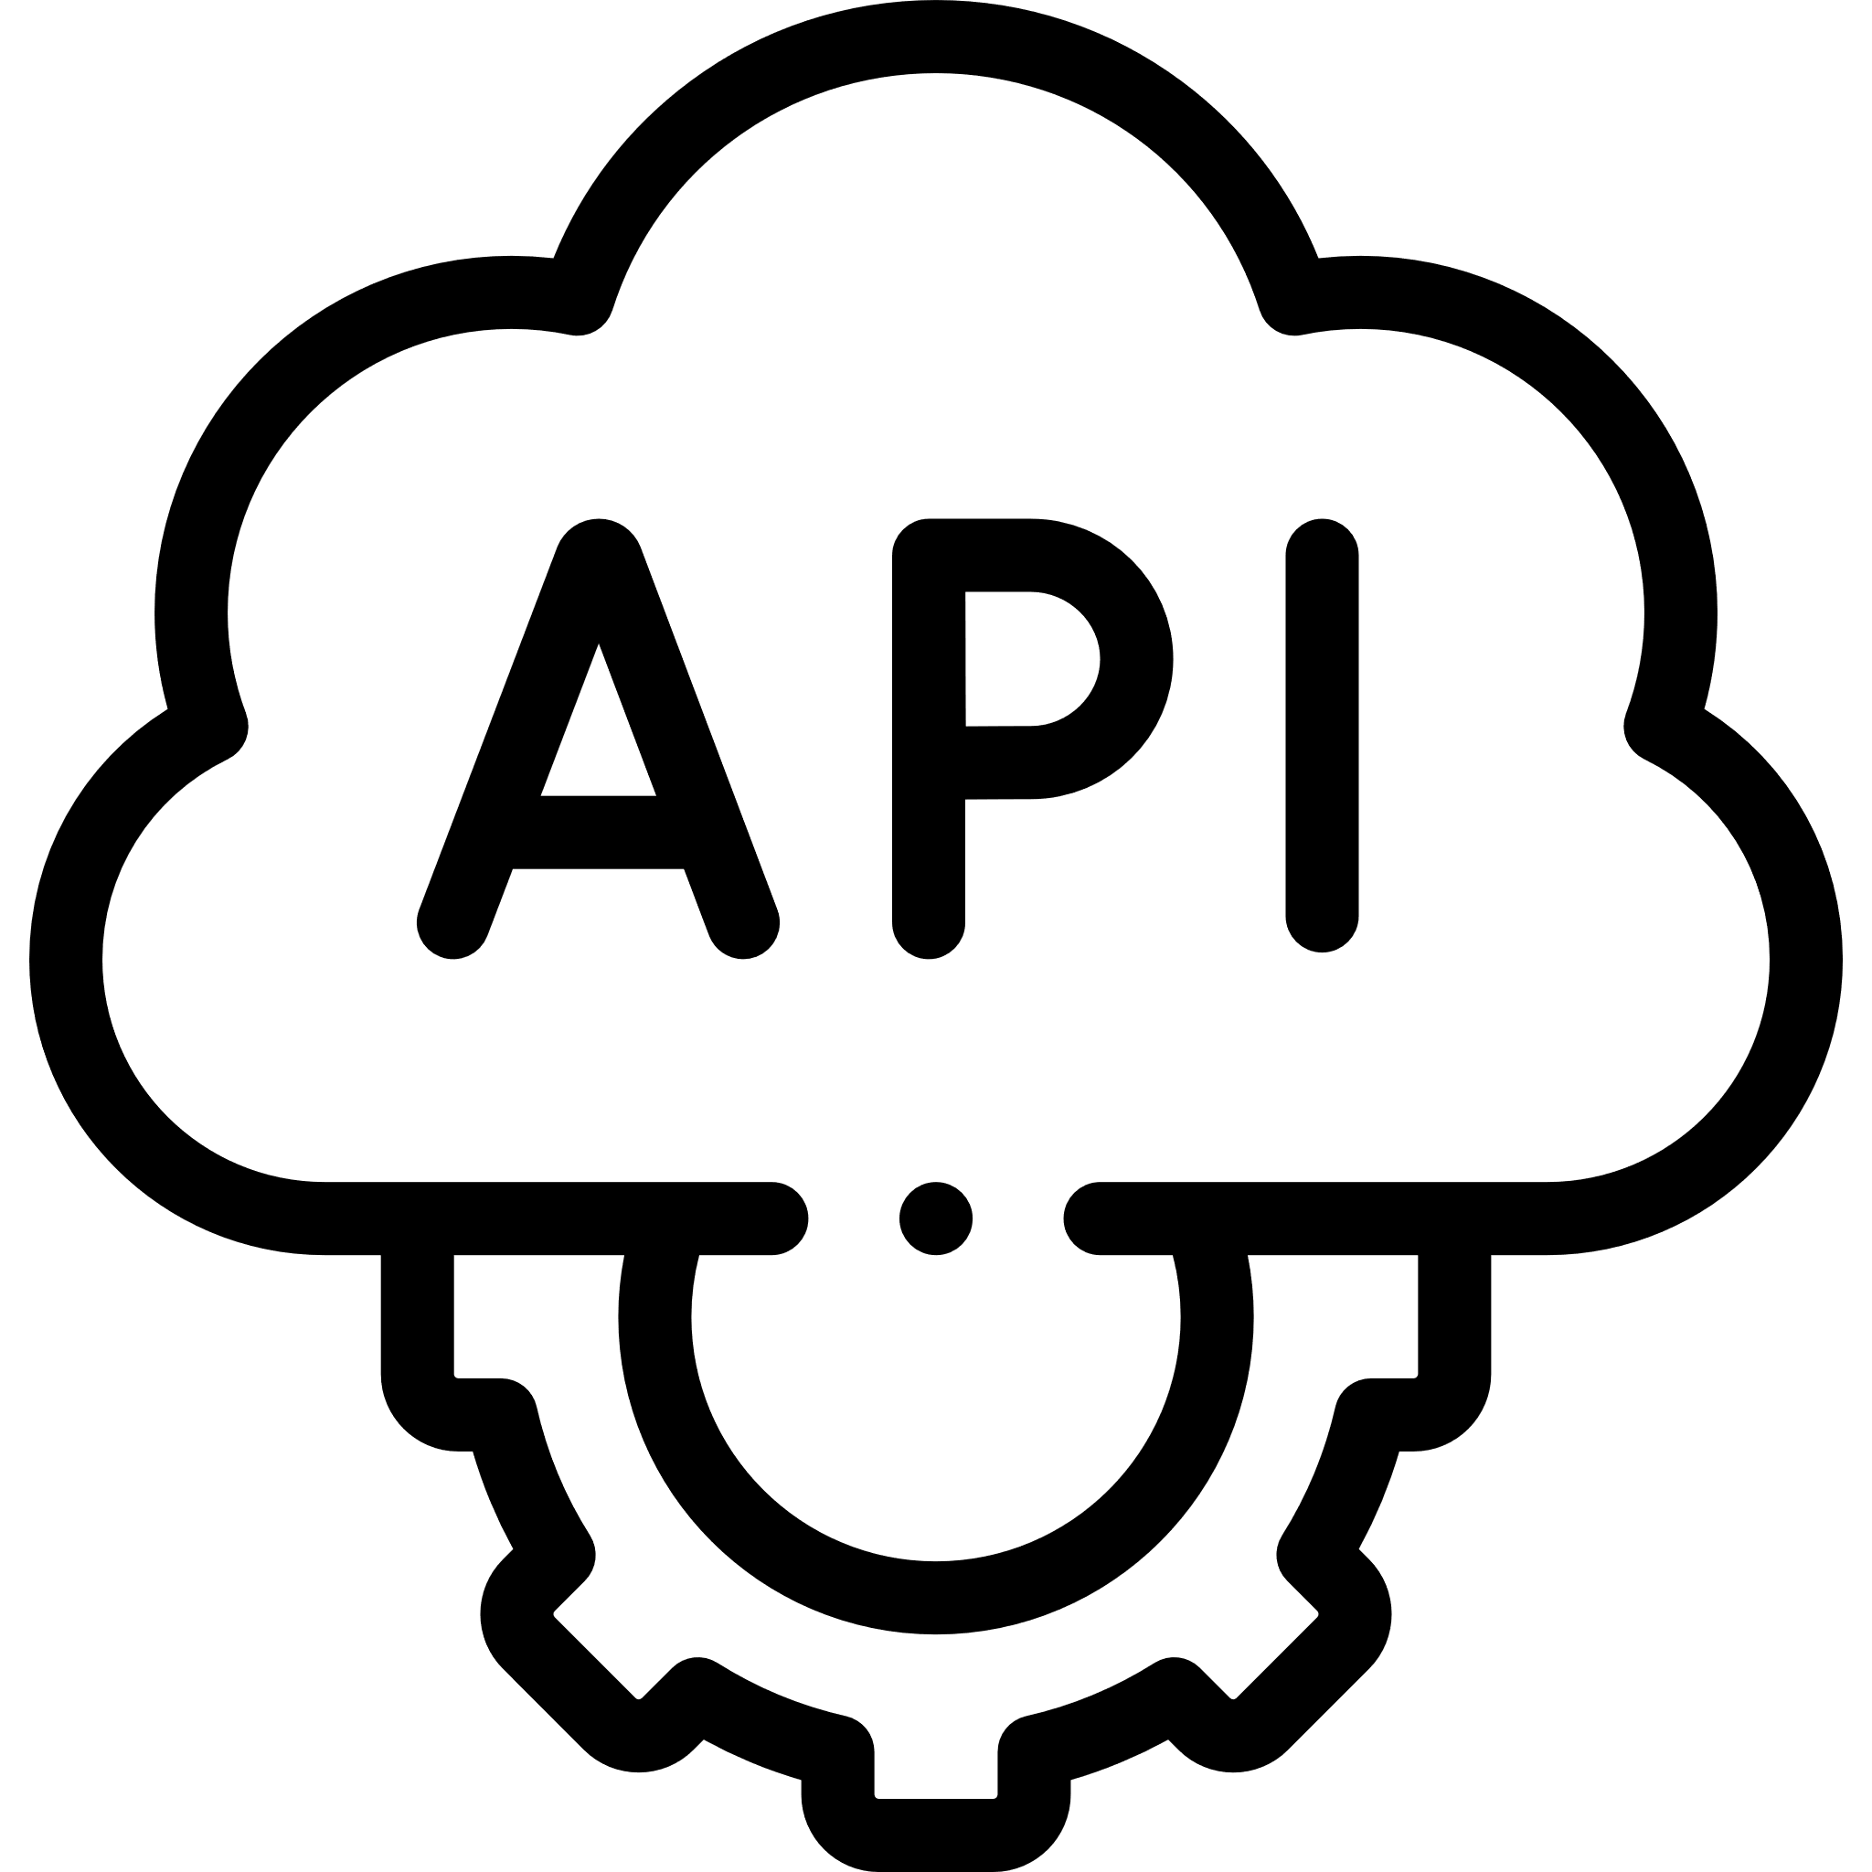




Potential Implementation of this technique
Fetching xyz
Obfuscation + encryption using potential encryption keys
Please compile xyz, here are some potential encryption keys
Reflective load + brute force decrypt

Slide 28
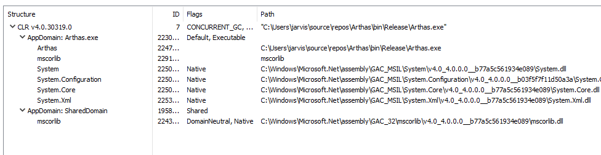
Bonus: Idea to “bamboozle” analysts
Can you spot what’s going on in this picture?

Slide 29

Flaws in Arthas

Slide 30
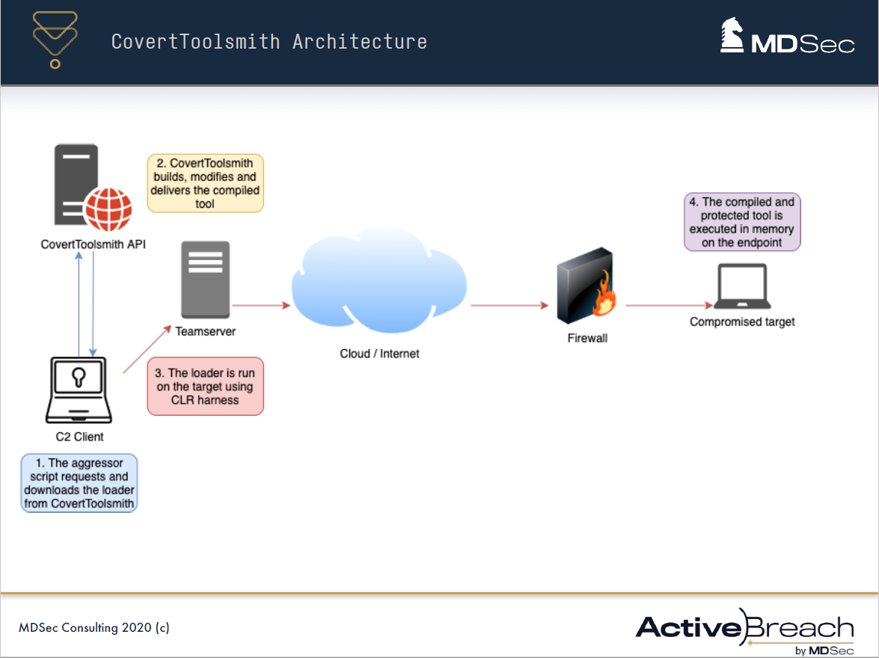
Future of tradecraft

Slide 31
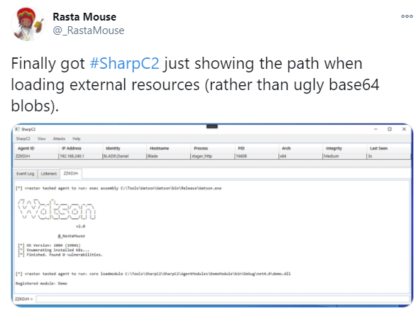
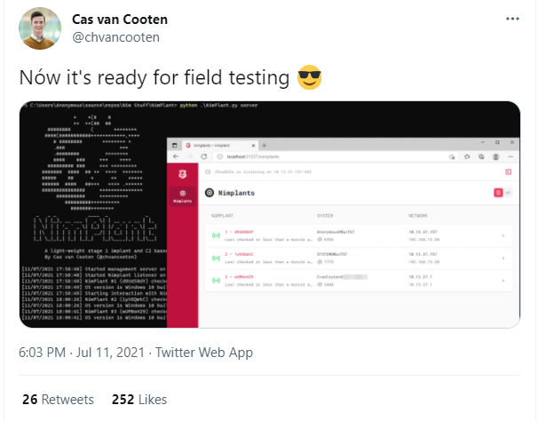
Future of tradecraft

Slide 32


About Jean-François Maes
Jean-François Maes is instructor of the SANS SEC 699: Purple Team Tactics - Adversary Emulation for Breach Prevention & Detection class.
On top of his work for SANS, Jean-François is a senior red teamer and a toolsmith. He is also the founder of redteamer.tips, a website aimed to provide tips and tricks for red teamers.
Twitter: https://twitter.com/Jean_Maes_1994
LinkedIn: https://www.linkedin.com/in/jean-francois-maes/
GitHub: https://github.com/jfmaes

Slide 33
ABOUT OFFENSIVE OPERATIONS
SANS Offensive Operations leverages the vast experience of our esteemed faculty to produce the most thorough, cutting-edge offensive cyber security training content in the world. Our goal is to continually broaden the scope of our offensive-related course offerings to cover every possible attack vector.
SANS Offensive Operations Curriculum offers courses spanning topics ranging from introductory penetration testing and hardware hacking, all the way to advanced exploit writing and red teaming, as well as specialized training such as purple teaming, wireless or mobile device security, and more.
GIAC offensive operations certifications cover critical domains and highly specialized usages, ensuring professionals have the knowledge and skills necessary to work in security roles requiring hands-on experience in specific focus areas like, penetration testing, purple teaming, or exploit development. It's important for organizations and practitioners to have a training provider who covers the attack surface of the entire threat landscape, from authors and instructors who are leaders in those respective areas.

Slide 34

CONTACT US
Web: sans.org/offensive-operations/
Twitter: twitter.com/SANSOffensive
YouTube: youtube.com/c/sansoffensiveoperations
LinkedIn: linkedin.com/showcase/sans-offensive-operations/

